Slide 1
GAUSS Seminar: SVD, PCA, …
3/24/2012
Xin Li

Slide 2
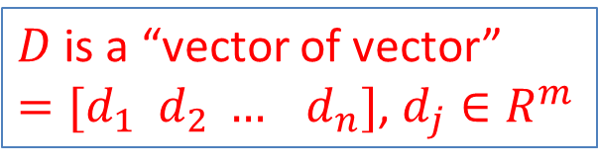
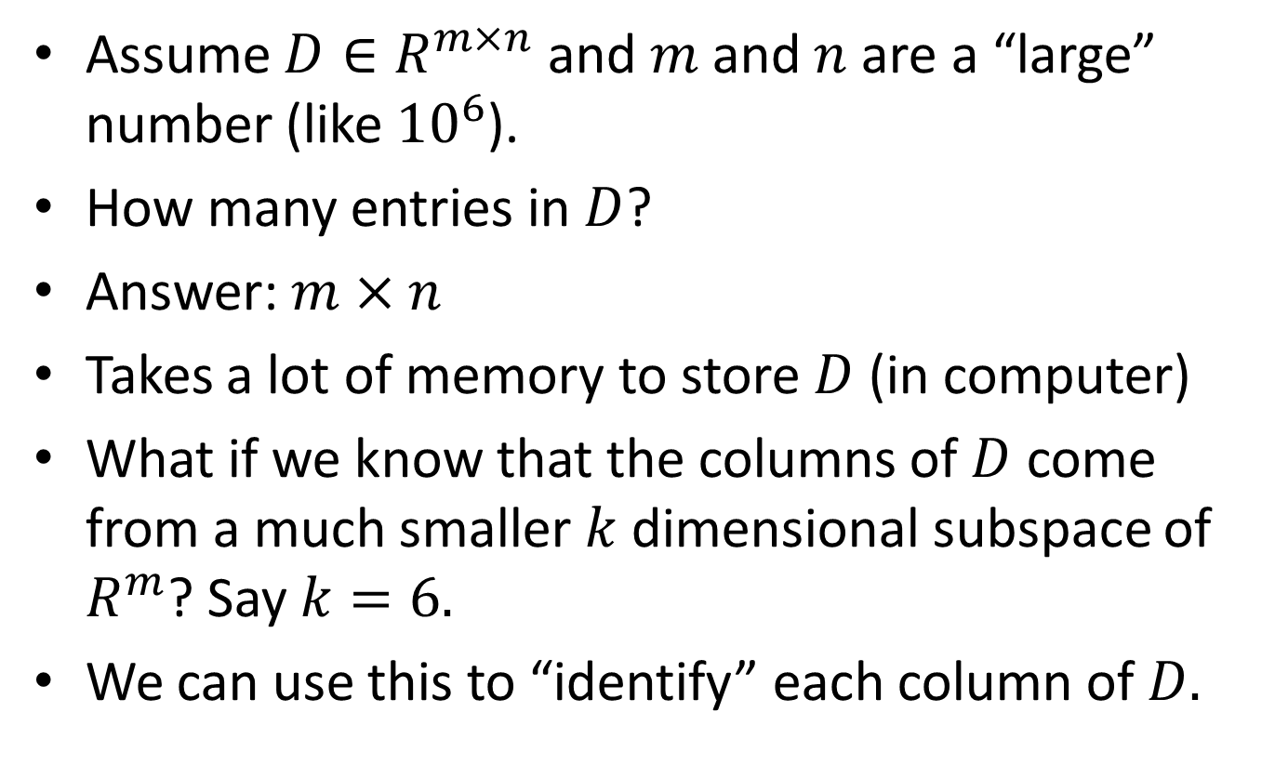
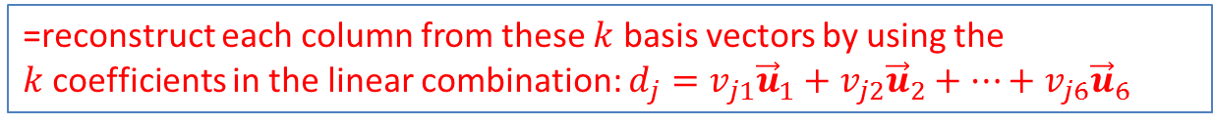
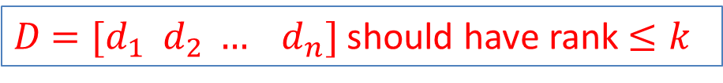
Recall: Represent Matrix Using Its Column Basis
Assume $D∈R^{m×n}$ and $m$ and $n$ are a “large” number (like ${10}^{6}$).
How many entries in $D$?
Answer: $m×n$
Takes a lot of memory to store $D$ (in computer)
What if we know that the columns of $D$ come from a much smaller $k$dimensional subspace of $R^{m}$? Say $k=6.$
We can use this to “identify” each column of $D.$
$D$ is a “vector of vector” $=[d_{1} d_{2} … d_{n}]$, $d_{j}∈R^{m}$
$D$ $=[d_{1} d_{2} … d_{n}]$ should have rank $≤k$
=reconstruct each column from these $k$ basis vectors by using the $k$coefficients in the linear combination: $d_{j}=v_{j1}{\vec{u}}_{1}+v_{j2}{\vec{u}}_{2}+…+v_{j6}{\vec{u}}_{6}$

Slide 3
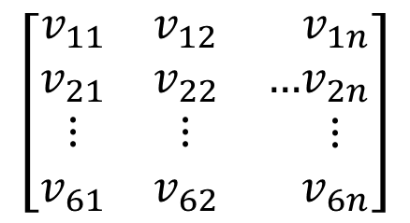
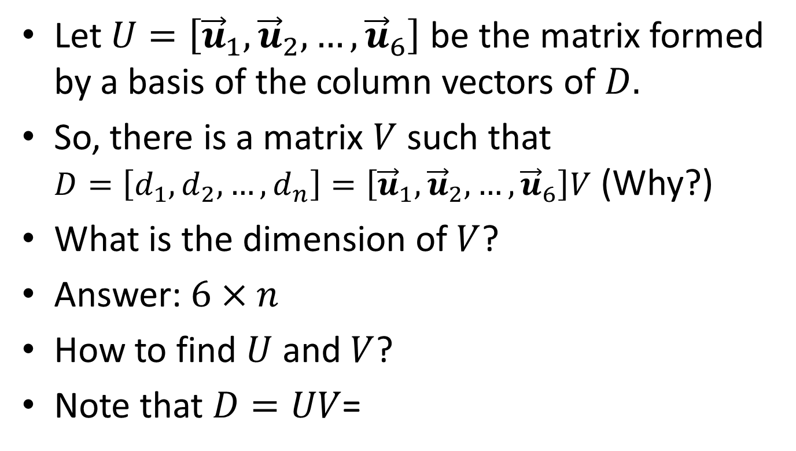
Recall: Dimension Reduction
Let $U=\left[{\vec{u}}_{1},{\vec{u}}_{2}, …,{\vec{u}}_{6}\right]$ be the matrix formed by a basis of the column vectors of $D.$
So, there is a matrix $V$ such that
$D=\left[d_{1},d_{2},…, d_{n}\right]=\left[{\vec{u}}_{1},{\vec{u}}_{2},…,{\vec{u}}_{6}\right]V$ (Why?)
What is the dimension of $V$?
Answer: $6×n$
How to find $U$ and $V$?
Note that $D=UV$=
$$\left[\begin{matrix}v_{11} & v_{12} & \\ v_{21} & v_{22} & … \\ \begin{matrix}⋮ \\ v_{61}\end{matrix} & \begin{matrix}⋮ \\ v_{62}\end{matrix} & \end{matrix}\begin{matrix}v_{1n} \\ v_{2n} \\ \begin{matrix}⋮ \\ v_{6n}\end{matrix}\end{matrix}\right]$$

Slide 4
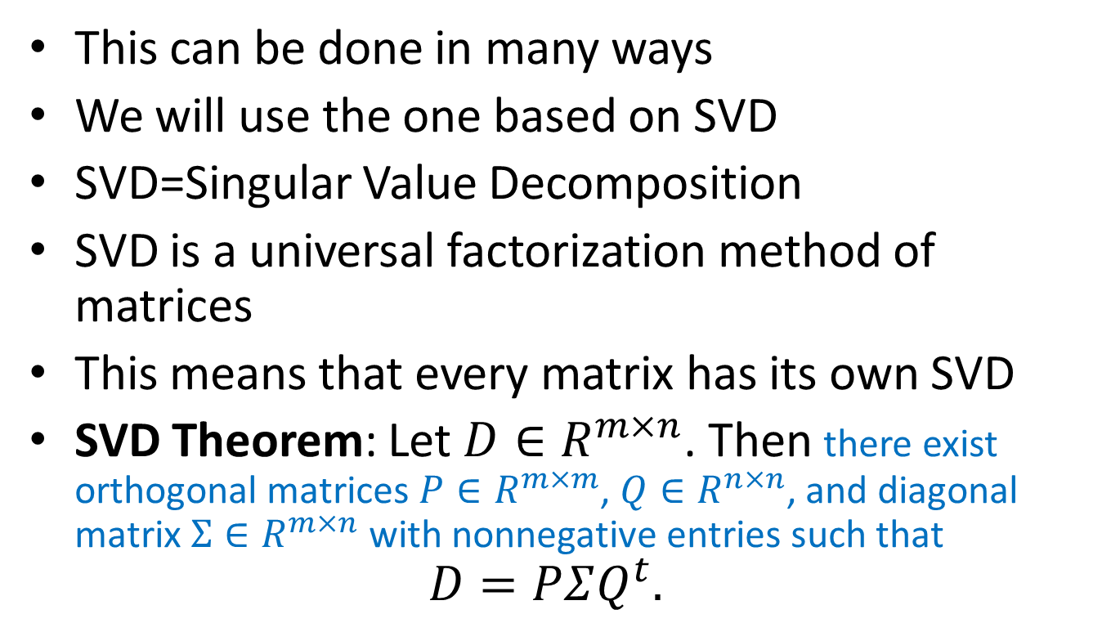
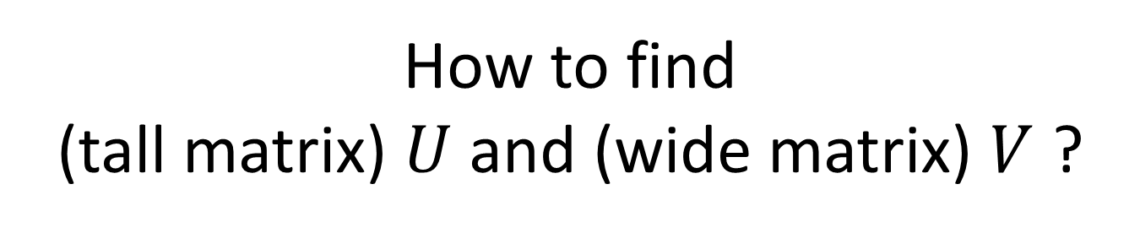
How to find
(tall matrix) $U$ and (wide matrix) $V$ ?
This can be done in many ways
We will use the one based on SVD
SVD=Singular Value Decomposition
SVD is a universal factorization method of matrices
This means that every matrix has its own SVD
SVD Theorem: Let $D∈R^{m×n}$. Then there exist orthogonal matrices $P∈R^{m×m}$, $Q∈R^{n×n}$, and diagonal matrix $Σ∈R^{m×n}$ with nonnegative entries such that
$D=PΣQ^{t}.$

Slide 5
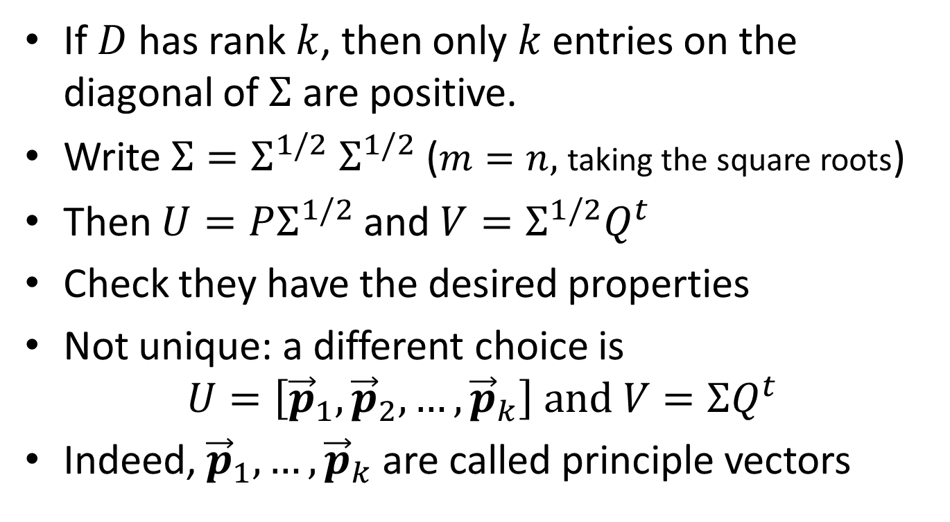
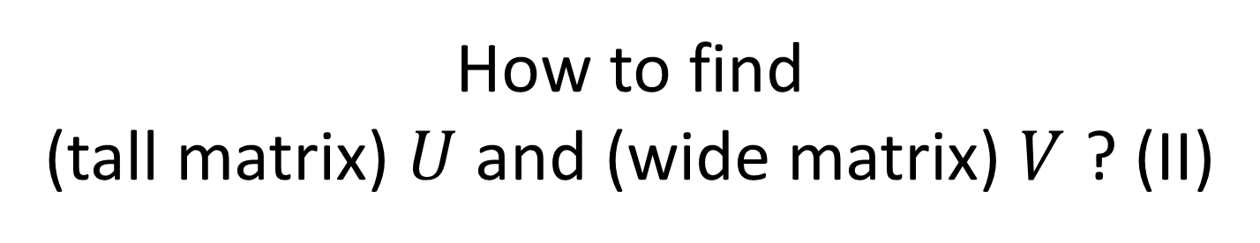
How to find
(tall matrix) $U$ and (wide matrix) $V$ ? (II)
If $D$ has rank $k$, then only $k$entries on the diagonal of $Σ$ are positive.
Write $Σ=Σ^{1/2} Σ^{1/2}$ ($m=n,$taking the square roots)
Then $U=PΣ^{1/2}$ and $V=Σ^{1/2}Q^{t}$
Check they have the desired properties
Not unique: a different choice is
$U=\left[{\vec{p}}_{1},{\vec{p}}_{2},…,{\vec{p}}_{k}\right] and V=ΣQ^{t}$
Indeed, ${\vec{p}}_{1}, …, {\vec{p}}_{k}$ are called principle vectors

Slide 6

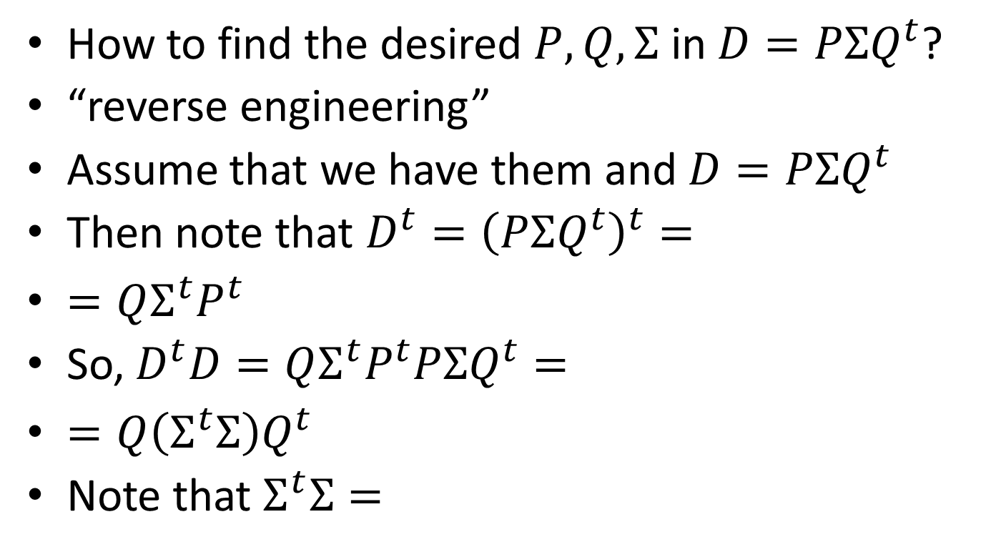
Deriving SVD
How to find the desired $P, Q, Σ$ in $D=PΣQ^{t}$?
“reverse engineering”
Assume that we have them and $D=PΣQ^{t}$
Then note that $D^{t}={\left(PΣQ^{t}\right)}^{t}=$
$=QΣ^{t}P^{t}$
So, $D^{t}D=QΣ^{t}P^{t}PΣQ^{t}=$
$=Q\left(Σ^{t}Σ\right)Q^{t}$
Note that $Σ^{t}Σ=$
$$\left[\begin{matrix}σ_{1}^{2} & & 0 \\ & σ_{2}^{2} & \\ 0 & & ⋱\end{matrix}\right]∈R^{n×n}$$

Slide 7
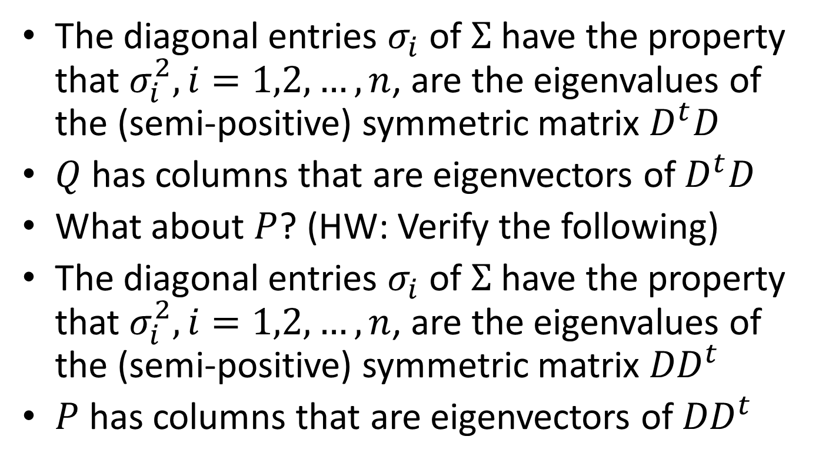

We found $Σ$ and $Q$!
The diagonal entries $σ_{i}$ of $Σ$ have the property that $σ_{i}^{2}, i=1,2,…, n$, are the eigenvalues of the (semi-positive) symmetric matrix $D^{t}D$
$Q$ has columns that are eigenvectors of $D^{t}D$
What about $P$? (HW: Verify the following)
The diagonal entries $σ_{i}$ of $Σ$ have the property that $σ_{i}^{2}, i=1,2,…, n$, are the eigenvalues of the (semi-positive) symmetric matrix ${DD}^{t}$
$P$ has columns that are eigenvectors of ${DD}^{t}$

Slide 8
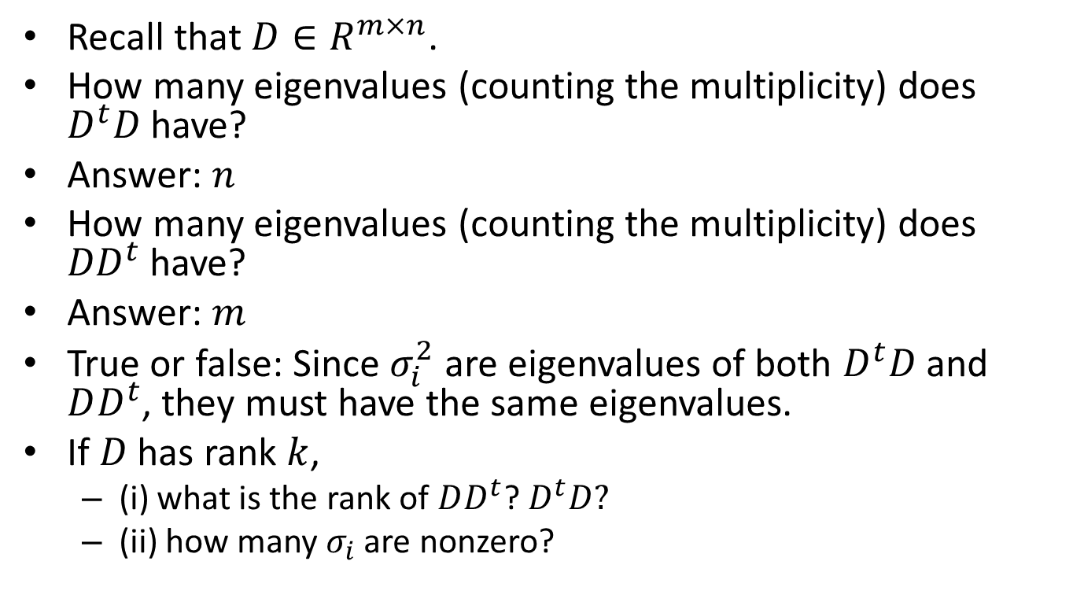
Quiz
Recall that $D∈R^{m×n}$.
How many eigenvalues (counting the multiplicity) does $D^{t}D$have?
Answer: $n$
How many eigenvalues (counting the multiplicity) does ${DD}^{t}$have?
Answer: $m$
True or false: Since $σ_{i}^{2}$ are eigenvalues of both $D^{t}D$ and $DD^{t}$, they must have the same eigenvalues.
If $D$ has rank $k$,
  (i) what is the rank of $DD^{t}$? $D^{t}D?$
  (ii) how many $σ_{i}$ are nonzero?

Slide 9
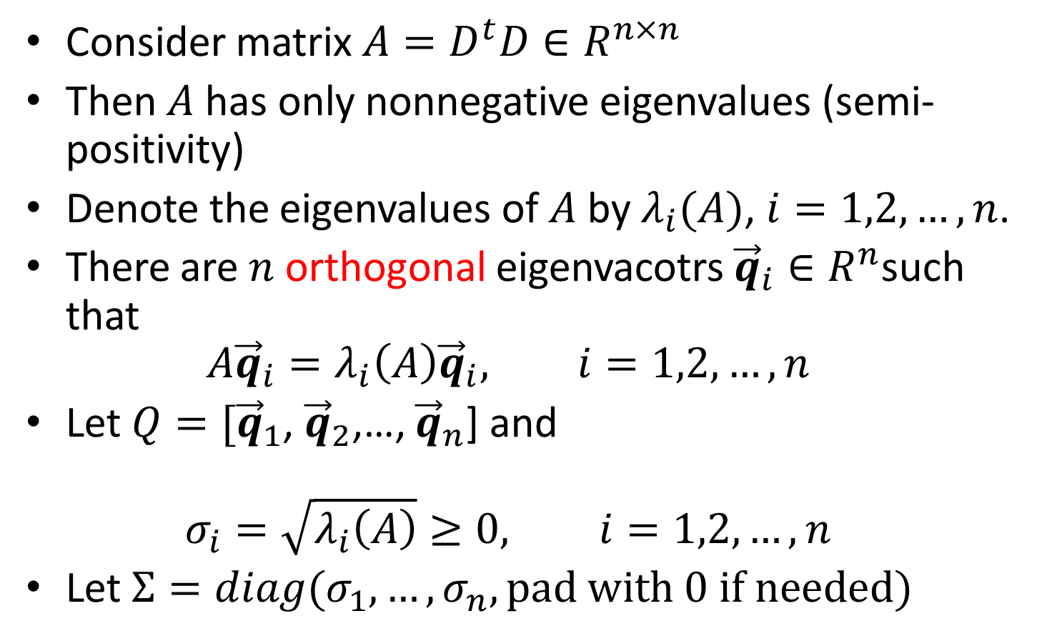
Proof of SVD
Consider matrix ${A=D}^{t}D∈R^{n×n}$
Then $A$ has only nonnegative eigenvalues (semi-positivity)
Denote the eigenvalues of $A$ by $λ_{i}(A)$, $i=1,2,…,n$.
There are $n$orthogonal eigenvacotrs ${\vec{q}}_{i}∈R^{n}$such that
$A{\vec{q}}_{i}=λ_{i}\left(A\right){\vec{q}}_{i}, i=1,2,…,n$
Let $Q=[{\vec{q}}_{1}$, ${\vec{q}}_{2}$,…, ${\vec{q}}_{n}$] and
$σ_{i}=\sqrt{λ_{i}\left(A\right)}≥0, i=1,2,…,n$
Let $Σ=diag(σ_{1},…,σ_{n},pad with 0 if needed)$

Slide 10
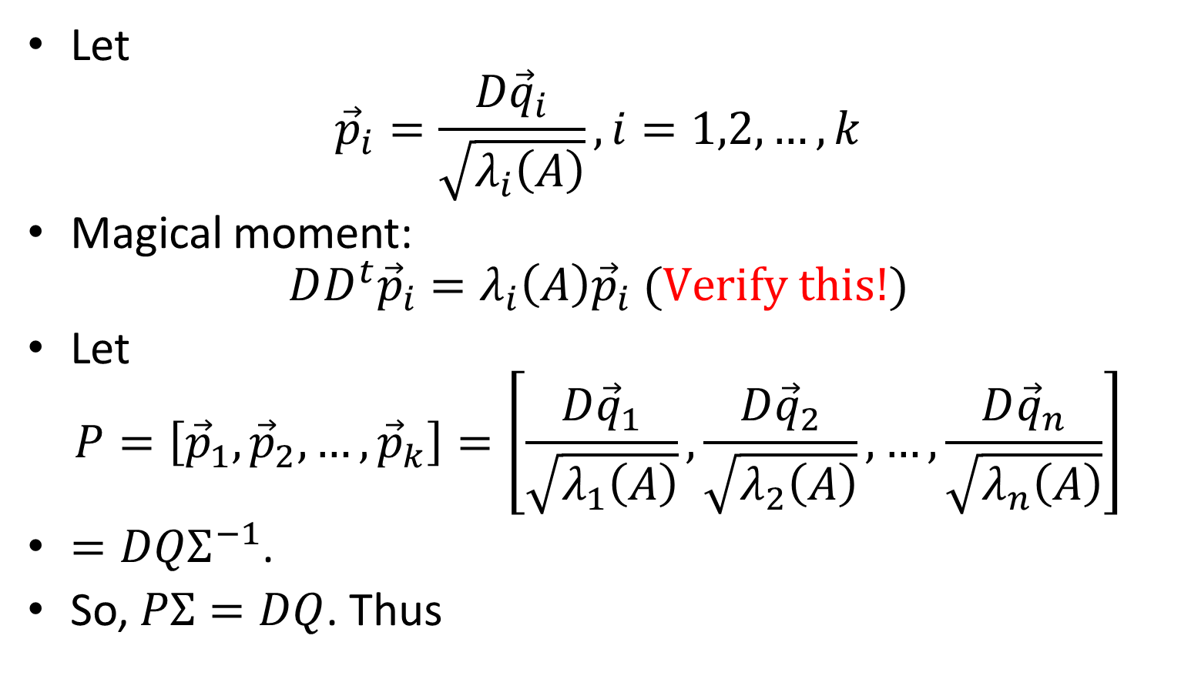


Will These Choices for $Σ$ and $Q$ work?
Let
${\vec{p}}_{i}=\frac{D{\vec{q}}_{i}}{\sqrt{λ_{i}\left(A\right)}}, i=1,2,…,k$
Magical moment:
$DD^{t}{\vec{p}}_{i}=λ_{i}\left(A\right){\vec{p}}_{i} (Verify this!)$
Let
$P=\left[{\vec{p}}_{1},{\vec{p}}_{2}, …, {\vec{p}}_{k}\right]=\left[\frac{D{\vec{q}}_{1}}{\sqrt{λ_{1}\left(A\right)}},\frac{D{\vec{q}}_{2}}{\sqrt{λ_{2}\left(A\right)}},…,\frac{D{\vec{q}}_{n}}{\sqrt{λ_{n}\left(A\right)}}\right]$
$=DQΣ^{−1}$.
So, $PΣ=DQ$. Thus
$$D=PΣQ^{t}$$

Slide 11
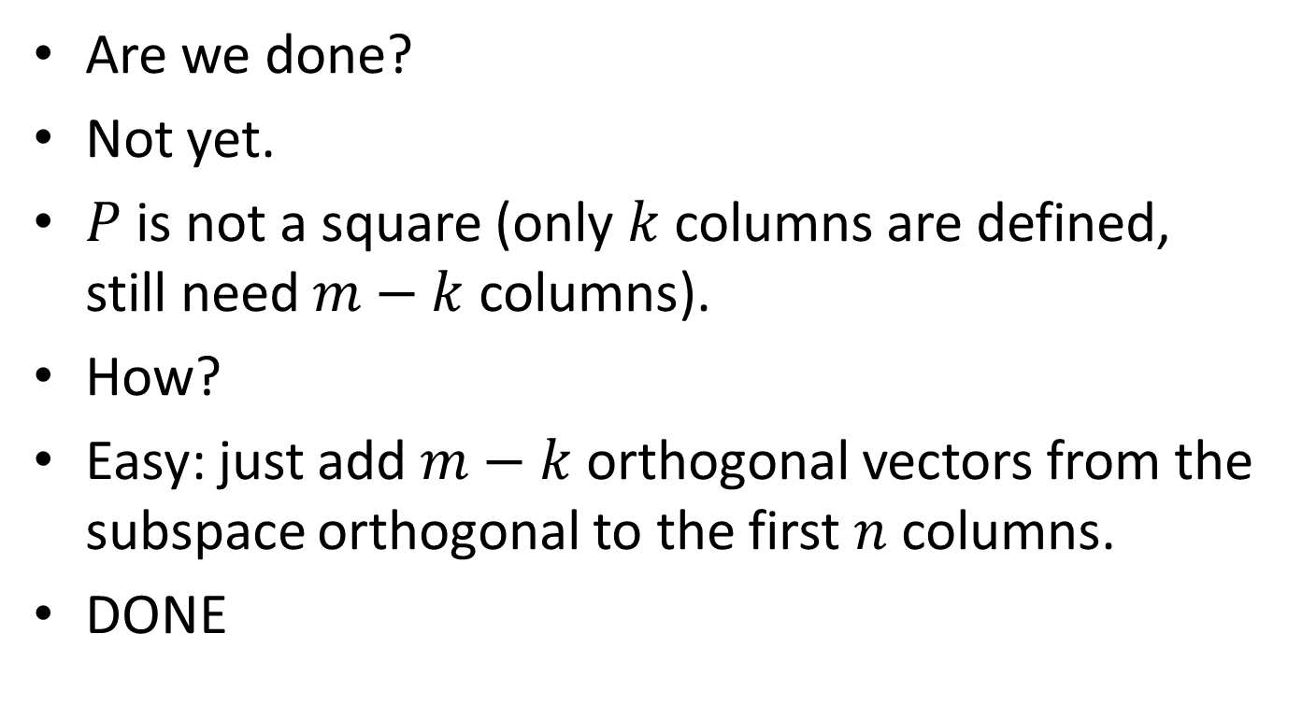
Almost Done
Are we done?
Not yet.
$P$ is not a square (only $k$ columns are defined, still need $m−k$ columns).
How?
Easy: just add $m−k$ orthogonal vectors from the subspace orthogonal to the first $n$ columns.
DONE

Slide 12
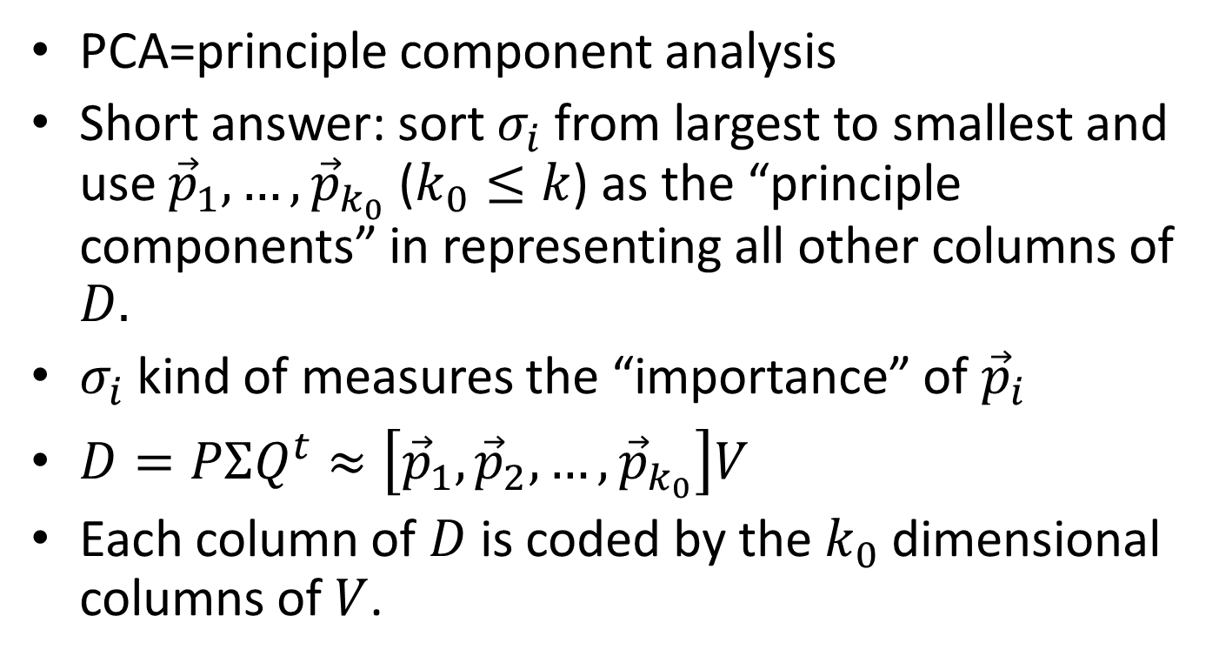
Use of SVD for PCA Algorithm
PCA=principle component analysis
Short answer: sort $σ_{i}$from largest to smallest and use ${\vec{p}}_{1},…, {\vec{p}}_{k_{0}}$ ($k_{0}≤k$) as the “principle components” in representing all other columns of $D.$
$σ_{i}$ kind of measures the “importance” of ${\vec{p}}_{i}$
$D=PΣQ^{t}≈\left[{\vec{p}}_{1},{\vec{p}}_{2},…,{\vec{p}}_{k_{0}}\right]V$
Each column of $D$is coded by the $k_{0}$ dimensional columns of $V$.

Slide 13
Assignments
Do all the “Verify” in the slides and write up your solutions. I will collect them next Friday.
Keep using Matlab and read the documentation about eig, svd, …

